Slide 1

“The Wild Boar George Gunned Down” (1978) Matayoshi Eiki (1947-)
ジョージが射殺した猪
又吉栄喜

Slide 2
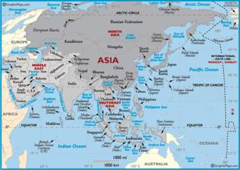
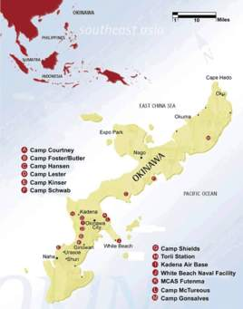
Maps

Slide 3
Keywords
Akutagawa Prize, 1996 (Pig’s Revenge)
Murakami Ryû, Almost Transparent Blue (1976)
Vietnam War
R&R
Wild Boar Incident
The Koza Uprising, December 1970
Koza (Okinawa City)
The Bush, Teruya
A-sign, off-limit orders
Proclamation 817 (Status of Forces Agreement or SOFA)

Slide 4
Discussion Questions
How is George depicted in the story? Okinawans? Other American soldiers?
2. Why does George shoot his gun?
In what character does your sympathy lie? Why?
How does this story differ from others we have read to date?

